Slide 1
[Production title]
Sustainable Production Guidelines
[Add company logo]
Notes:
To action before session
Register on albert
Talk to departments and assign sustainability champions
Talk to accounts about gathering financial information on the savings or costs of sustainability initiatives and tagging and tracking relevant materials for our footprint calculation

Slide 2
[Company] & sustainability
We are committed to improving sustainability on our productions
We need to transition towards low-carbon production
We are using the Sustainable Production Guidelines to guide us and our production teams in key decisions
These are aligned to albert sustainable production certification
Notes:
At [Company] we’re committed to improving sustainability on our productions, and to finding ways of working that will contribute to a future we can live, thrive and continue to create in.
We are in a climate crisis, and we know that as a business and as individuals we need to be part of emissions reductions year on year, in order to contain global warming and preserve the natural world
The ambition is to transition towards low-carbon production, where we have a positive rather than negative impact on our environment.
We have share our Sustainable Production Guidelines - take a look at the sections relevant to you, in order to inform the key decisions you make on this production.
The Guidelines are aligned to albert’s sustainable production certification, and we hope we can achieve certification on this production.

Slide 3

Everyone can make a difference
“What you do makes a difference, and you have to decide what kind of difference you want to make.” Jane Goodall
Everyone can influence changes in the areas they control
Think about what can you do in your role - decisions you control and influence
Discuss and share good ideas
Talk to your suppliers
Notes:
Everyone can make a difference – we can all influence changes in the areas we control
Think about what would work for your department and what else you can do in your area
Talk to your team and to us, so we can share ideas and come up with solutions
Let us know how we can support you
Ask the suppliers you work with what they’re doing letting them know you care about the issues. We can really increase our impact by influencing those who work with us
And do what you can in your own daily routine however small that may seem – as a whole crew it will make a difference

Slide 4

Our goals
On this production, we want to:
Measure our footprint and work for albert sustainable production certification
Focus on actions with meaningful impacts
Support you to make any changes where you can
Notes:
As a production we want to measure our footprint using albert’s carbon calculator and work for sustainable production certification
We want to be guided by the science and the data, focusing on actions that have meaningful impacts on reducing our footprint
We want to support you wherever possible to make any changes you can

Slide 5

Energy & Fuel
We want to reduce reliance on fossil fuels
Sourcing power from the grid
Replacing diesel with biofuel
Asking crew to use power consciously, switching off or turning down whenever possible
Notes:
Have your Line Producer or Location Manager run this

Slide 6

Low energy solutions
We want our equipment to be as energy efficient
as possible
Using LED lighting on and off set where possible
Notes:
Have your Gaffer / DOP run this

Slide 7
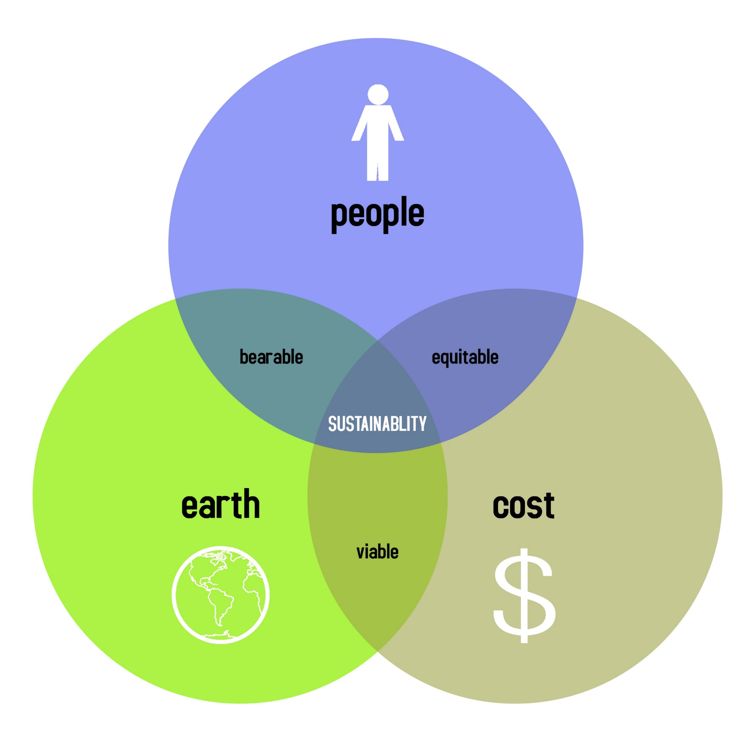
Materials
We want to use materials responsibly –
reuse, repurpose & recycle
Sourcing 2nd hand & renting
Sourcing materials made from recycled content or certified as made using renewable sources
Only buying what we need
Avoiding any materials that can’t be reused, repurposed or recycled
Passing on assets we no longer need
These measures mean we minimise waste from our workflows
Notes:
Have your Production Designer & Costume Designer run this

Slide 8
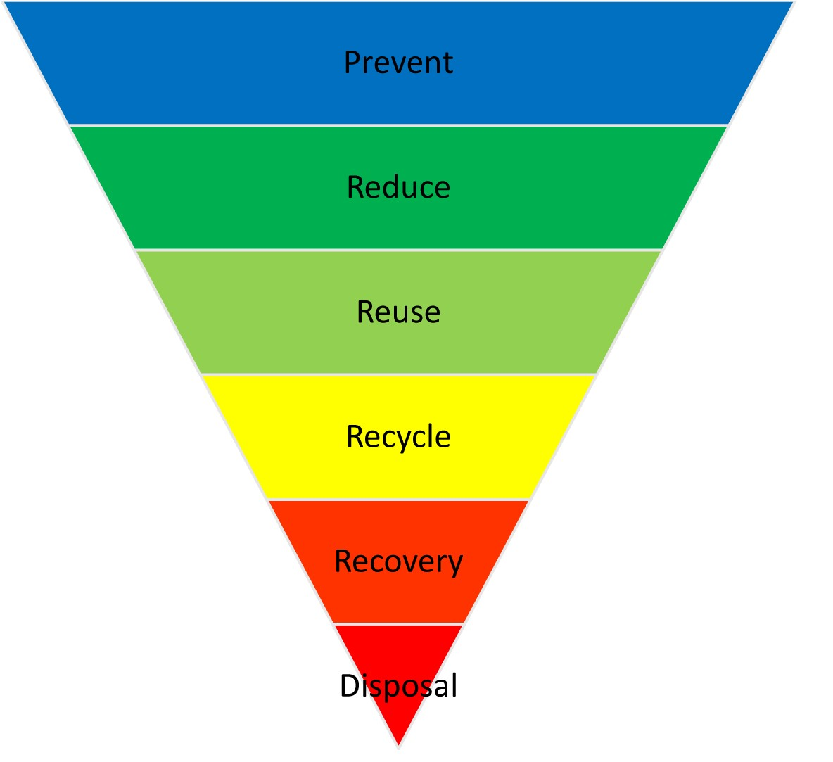
Reducing waste
We want to cut waste
Following the principles outlined in Materials
Avoiding unnecessary packaging and single use plastics
Reuse and repurpose wherever possible
Recycle whatever can be recycled
Dispose of waste responsibly following signage
Notes:
Have your Production or Locations run this

Slide 9
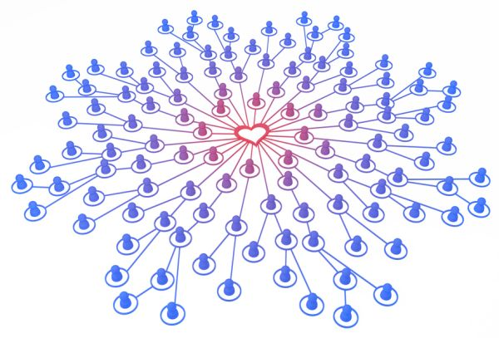
Our suppliers
We can increase our impact by influencing
our suppliers
Asking for environmental policies and emissions information when getting quotes
Factoring in green credentials when awarding contracts
Choosing local suppliers where possible
Sending suppliers a Suppliers Sustainability Memo
Following up with suppliers to check in on progress
Notes:
Have your Production run this

Slide 10

Protecting the environment
We want to respect the locations we are lucky
enough to film in
Communicating to cast and crew the importance of preserving the local environment
Reducing air pollution by reducing use of fossil fuels
Leaving no trace behind us
Notes:
Have your Location Manager run this

Slide 11

Post Production
And some options we are looking at for post
Encouraging our Post Houses to source power from renewables
Running a remote offline edit during assembly
Using Source Connect for ADR for those not local
Running remote meetings to reduce travel
Notes:
Have your Post Supervisor run this

Slide 12

Publicity
Our publicists will celebrate our efforts
Finding those on the team who are passionate about environmental issues
Asking questions in interviews
Gathering assets to tell sustainability stories
Encouraging cast & crew to provide content for stories they want to shout about
Notes:
Have your Publicist run this

Slide 13

Learning and sharing
We can amplify our impact by sharing learnings
with other producers & productions
Sharing learnings and advocating for change
Helping transform our industry into a regenerative one which has a positive impact on the environment
Notes:
Be measuring our footprint we’ll be able quantify the difference our actions make
We can then amplify that impact by sharing what we learn, passing on our experiences to other producers and productions
And advocating for change in the industry as a whole
Continual learning and sharing can help transform our industry into a regenerative one has a positive impact on the environment.

Slide 14

Questions and discussion points
Do you have questions or suggestions ?
What areas do you feel need improvement?
It is worth discussing options even if they are things we can’t change immediately or on this production

